Slide 1
Digital Sales Eco System

Slide 2
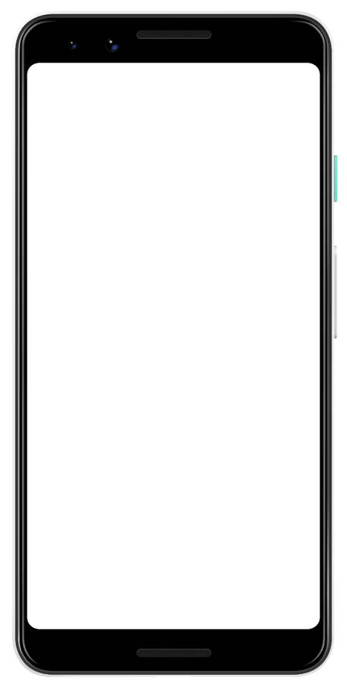
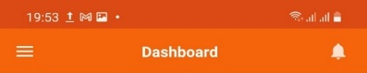
Digital Eco-system: Core KPI Reporting
KPI Report
Geography:
Cluster: All
Region: All
Zone All
Distributor: All
RSO Sup: All
RSO: All
KPI: Retail SCR
KPI
Retail SCR
Details | Recipient | Data Frequency
Less than 2 days stock %, Less than 1 day stock % | RSO, ZM, DD, Top | D-1
Parameter | Retail | %
Lees than 2D Stock | XXX | X%
Less than 1D Stock | XXX | X%

Slide 3
Digital Eco-system: Core KPI Reporting
KPI Report
Geography:
Cluster: All
Region: All
Zone All
Distributor: All
RSO Sup: All
RSO: All
KPI: RSO App Utilization
KPI
RSO App Utilization
Details | Recipient | Data Frequency
Plan Visit Count %, Actual Visit Count %, Memo count % | RSO, ZM, DD, Top | D-1
Parameter | Retail | %
Plan Visit | XXX | --
Actual Visit | XXX | XX%
Memo | XXX | XX%

Slide 4
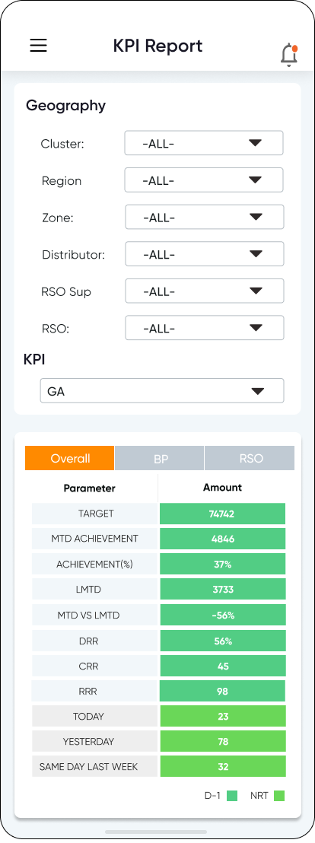
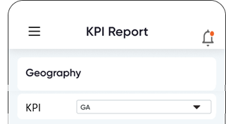
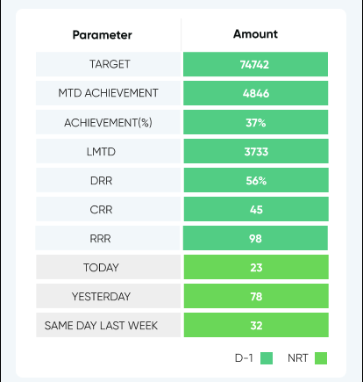
Digital Sales Eco System
Wireframe Sample
KPI: GA
KPI: GA
All Bundle
Overall
BP
Overall
BP
Details | Data Frequency
Target vs Ach, MTD vs LMTD, DRR/CRR/RR | D-1
Today, yesterday, last week same day | Near Real time
RSO wise Target vs Ach, MTD vs LMTD | D-1
Details | Data Frequency
Target vs Ach, MTD vs LMTD, DRR/CRR/RR | D-1
Today, yesterday, last week same day | Near Real time
RSO wise Target vs Ach, MTD vs LMTD | D-1

Slide 5
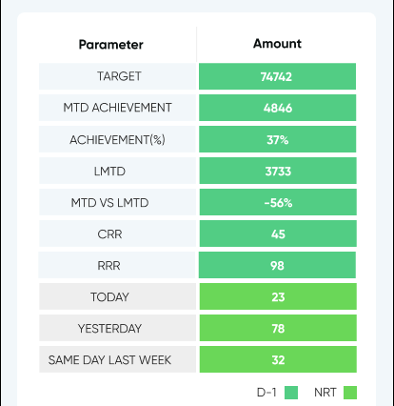
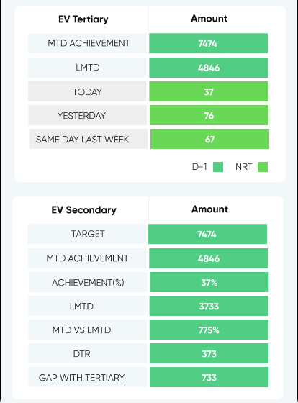
Digital Sales Eco System
Wireframe Sample
KPI: Data
KPI: EV
Data
EV
Details | Data Frequency
Target vs Ach, DRR/CRR/RR | D-1
MTD vs LMTD | D-1
Today, yesterday, last week same day | Near Real time
RSO wise Target vs ach, MTD vs LMTD | D-1
Details | Data Frequency
Tertiary MTD vs LMTD, today, last day, last week same day | Near Real Time
Secondary Target vs Ach, MTD vs LMTD, DTR, Gap With Tertiary | D-1

Slide 6
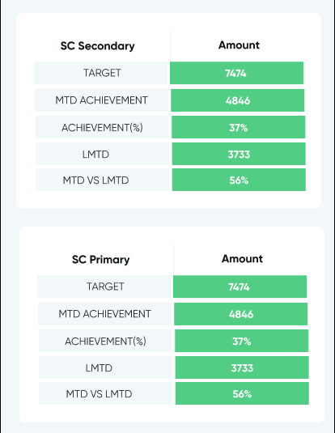
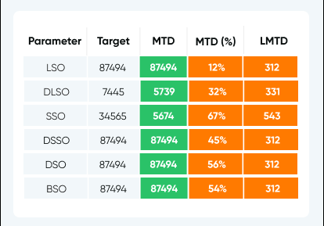
Digital Sales Eco System
Wireframe Sample
KPI: SC
KPI: LSO, DLSO, SSO, DSSO, BSO, DSO
Scratch Card
LSO, DLSO, SSO, DSSO, BSO, DSO
Details | Data Frequency
Secondary Target vs Ach, MTD vs LMTD | D-1
Primary Target vs Ach, MTD vs LMTD | D-1
Tertiary Target vs Ach, MTD vs LMTD | D-1
Details | Data Frequency
Target Vs Achievement, MTD vs LMTD | D-1

Slide 7
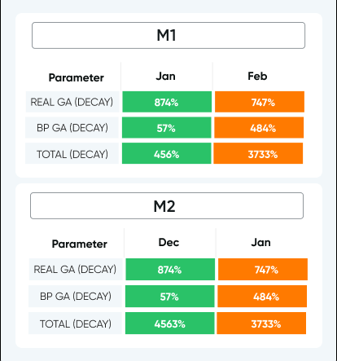
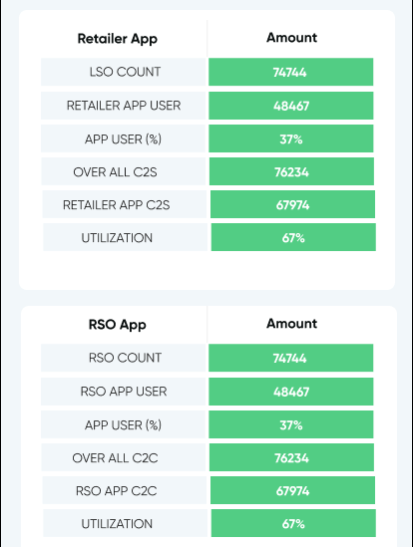
Digital Sales Eco System
Wireframe Sample
KPI: M1/M2 Decay
KPI: App Utilization
M1/M2 Decay
App Utilization
Details | Details
Retail GA (Decay) | Monthly
BP GA (Decay) | Monthly
Details | Data Frequency
Retailer App User | D-1
Retailer App Utilization | D-1
RSO App User | D-1
RSO App Utilization | D-1

Slide 8
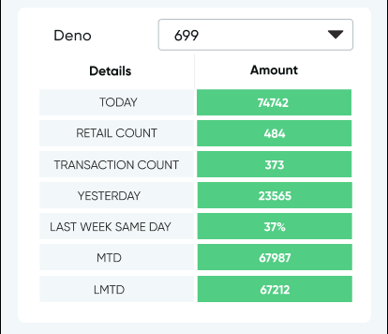
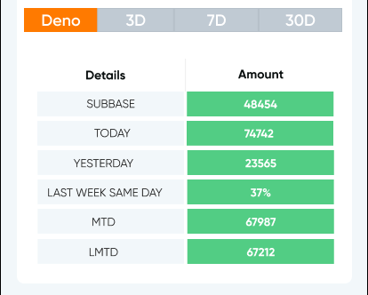
Digital Sales Eco System
Wireframe Sample
KPI: Deno
KPI: Deno Sub-base
Deno
All Bundle
Overall
Details | Data Frequency
Today, yesterday, last week same day, MTD Vs LMTD | Near Real Time
Details | Data Frequency
Subbase, today, yesterday, last week same day, MTD Vs LMTD, 3D, 7D, 30D | Near Real Time

Slide 9
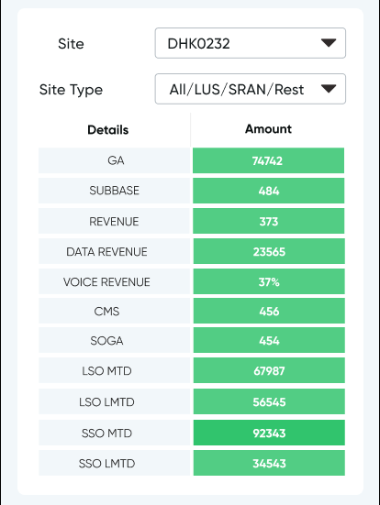
Digital Sales Eco System
Wireframe Sample
KPI: Site
Site
Details | Data Frequency
GA, Subbase, Rev, Data Revenue, Voice Revenue, CMS, SOGA, LSO, SSO (MTD, LMTD) | D-1

